Slide 1
Crossing Borders Peer-to-peer Education in Mechatronics

Slide 3
-Present peer-to-peer concept to students
1
-Propose peer-to-peer implementation by online methods
2
-Directly aid initial steps in order to implement peer-to-peer concept
3
-Successfully implement peer-to-peer methods
4
-Observe behavior of participating student
5
-Analyze the involvement of participating students
6

Slide 4
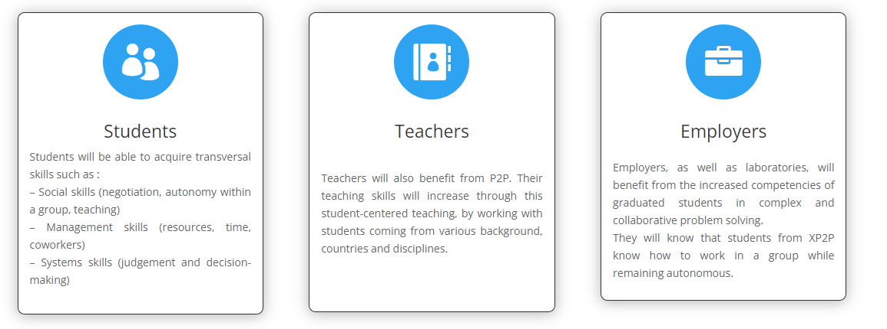
Why Peer to Peer learning?
-> students and teachers explore new ways of learning

Slide 5
Implementation &Intellectual Outputs
What is an IO?
O1- Mapping, scientific review on peer-to-peer learning in mechatronics
O2- Methodological framework for peer learning in mechatronics
O3-Handbook Guide to implement peer-to-peer teaching in mechatronics engineering studies
O4- Peer learning semester module through project-based learning in mechatronics
O5-Competency Portfolio Assessment guidelines
O6-Academic papers about peer learning in a post-graduate programme in mechatronics
O7-Creation of a European mechatronics network for peer learning and cooperation
Prototipare și testare
5

Slide 6
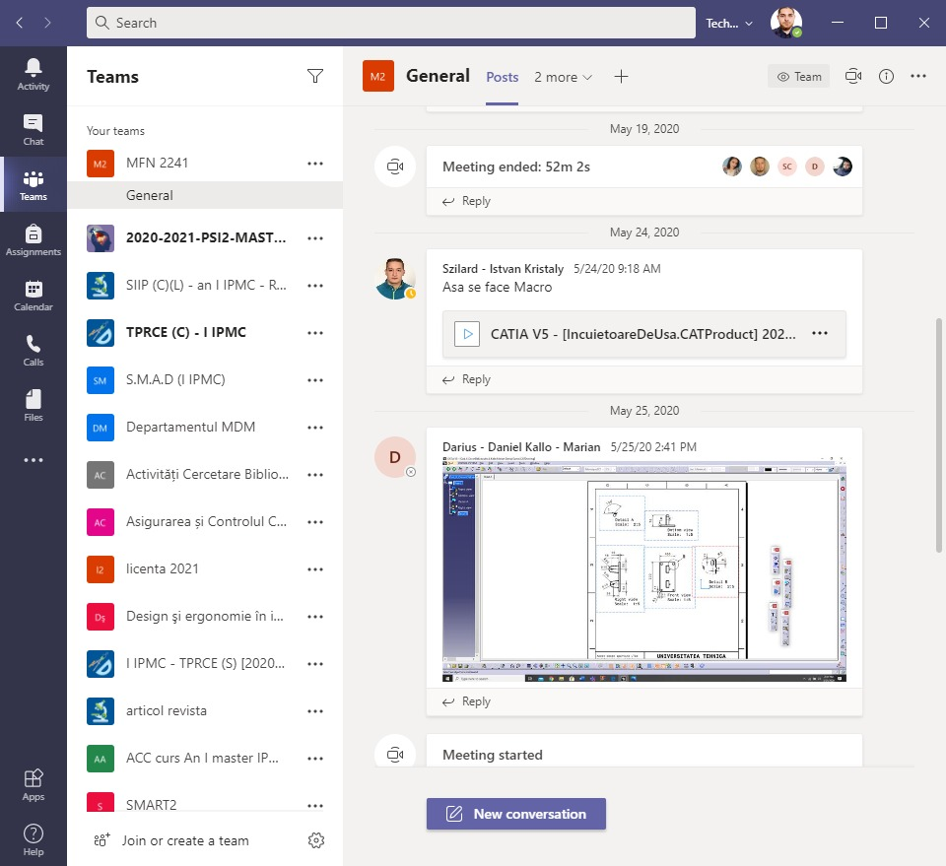
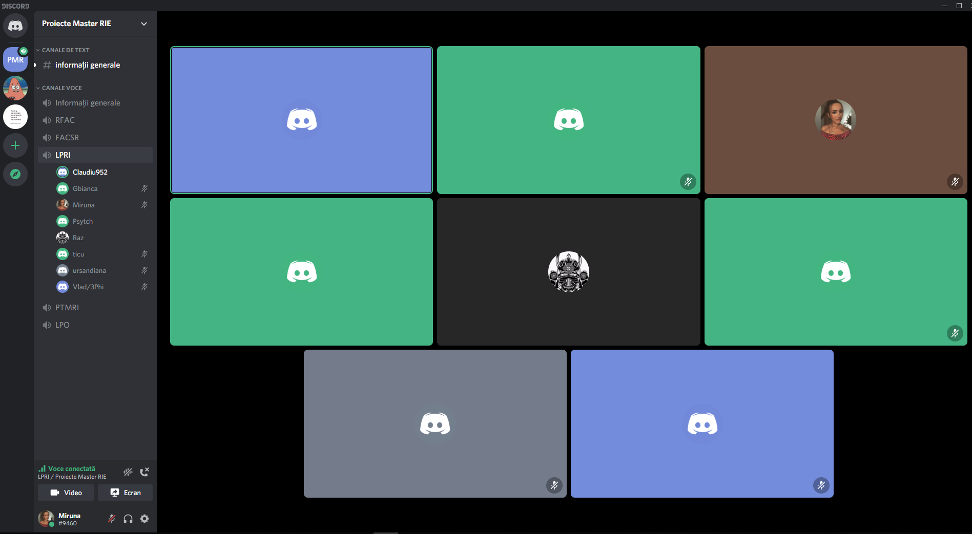
Platforms:
TEAMS-Microsoft Office 365
Discord

Slide 7
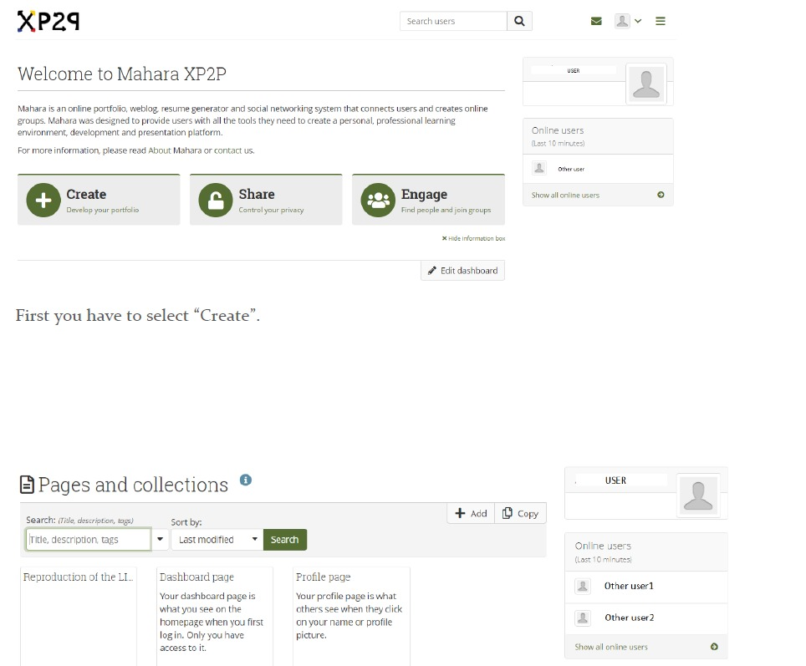
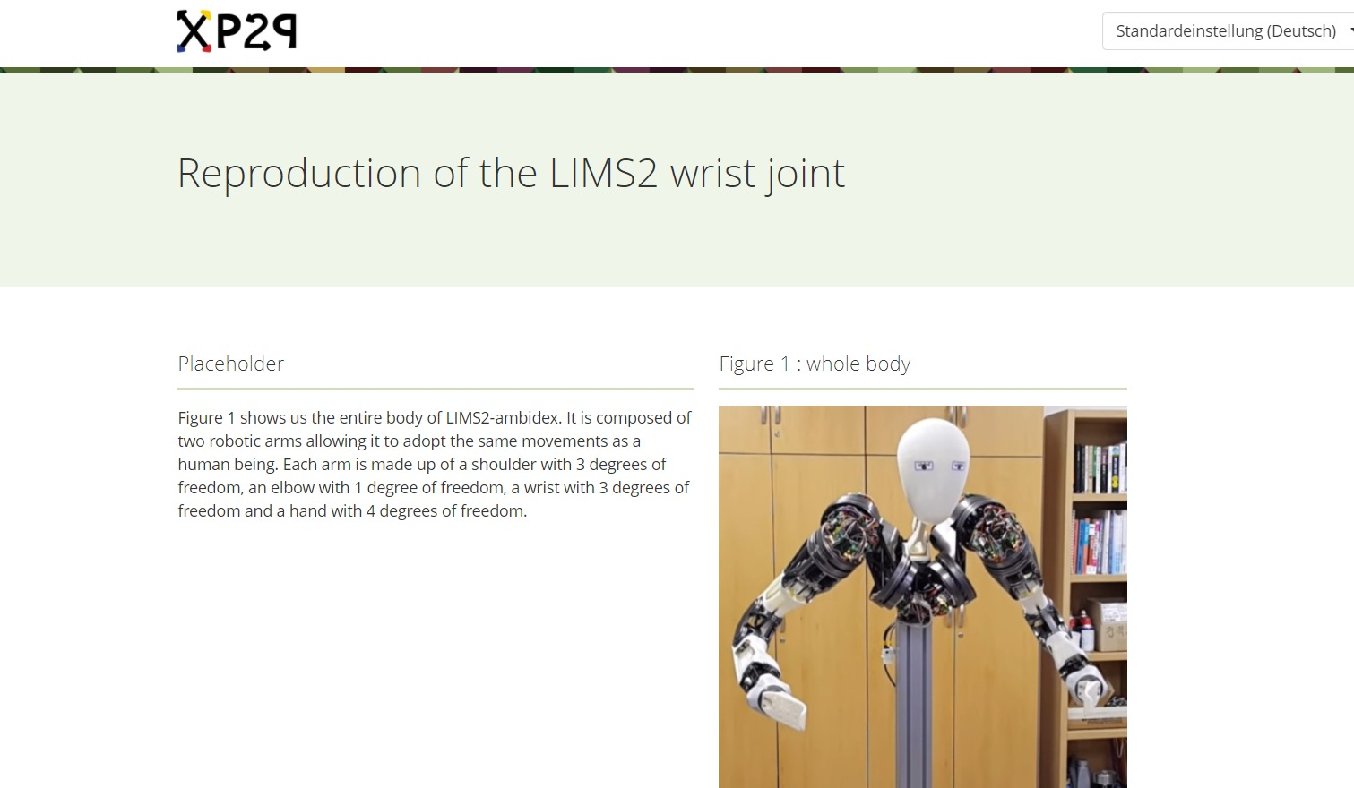
Mahara
-useful for peer-assessment
-tutorials on how to use Mahara
-E-portfolio
-uploading projects and home-works

Slide 8
Determination of a set of relevant methods to implement in Mechatronics learning during the first peer-to-peer semester.
Relevant skills for a mechatronics engineer
Problem solving
Thinking Critically
Making Decisions
Learning New Things

Slide 9
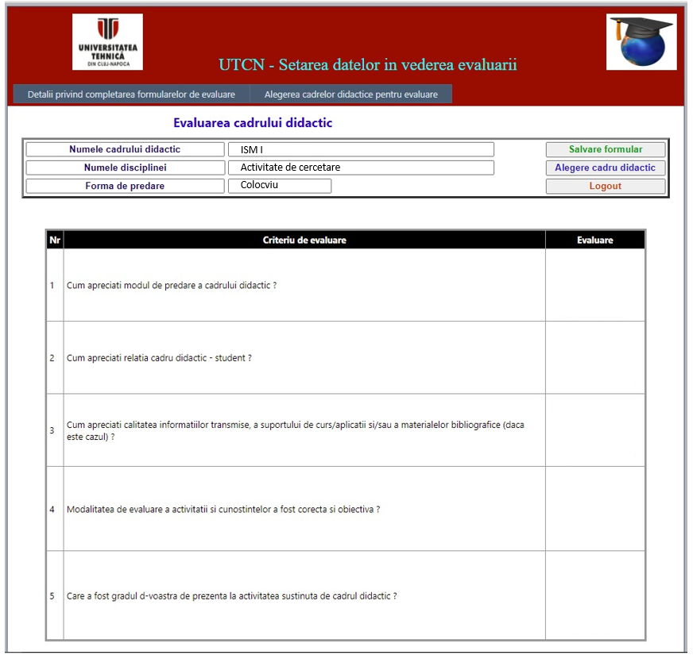
Collection of teachers' and students' feedback during and after the first peer-to-peer learning semester
What platform you mostly used for communication ?
Which part of your work was most effort consuming ?
Are you satisfied with the project you developed and explain why ?
From your opinion, what can be improved in this class ?
Are you satisfied by the implementations of the peer learning from this class ?

Slide 10
Corrected set of relevant methods to implement in Mechatronics learning during the second peer-to-peer semester.
Advanced programming in MATLAB
(1st year master Mechatronic Systems Engineering)
We have license for MATLAB
A large diversity of projects can be done
Good structured HELP
Online community forums
Tutorials can be easily found

Slide 11
Conclusions
Implementation of peer-to-peer concept using different platforms
Better communication with Erasmus students
Students working together + monitorization by teacher
Option to have an anonymous feedback from students

Slide 12
https://xp2p-project.eu/
Thank you for your attention!

